Slide 1
MECHANICAL
INJURIES

Slide 2
MECHANICAL INJURIES
Injury (44 IPC)
Injury is any harm ,whatever illegally caused to any person in body, mind, reputation or property.
Medically a wound or injury is a break of the natural continuity of any of the tissue of the living body.

Slide 3
Classification
1) Medical
2) Legal - Simple & Grievous
3) Medico legal - Suicidal
Homicidal
Accidental
Fabricated
Self inflicted
Defence

Slide 4
MEDICAL
I. Mechanical
A. Due to blunt force - 1. Abrasion
2. Contusion
3. Laceration
4. Fracture & dislocation
B. Due to sharp force - Incision
Stab wound
Chop wound
C. Firearms - Firearm wound
Blast injuries

Slide 5
II. Thermal injuries
1. Due to cold: a) Frostbite
b) Trench foot
c) Immersion foot
2. Due to heat: a) Burns
b) Scalds

Slide 6
III. Chemical injuries- a) Corrosive acids
b) Corrosive alkalis
V. Physical injuries - Electricity
Lightening
Radiation
Radioactive substances
V. Explosions

Slide 7
General Principles
The wound is caused by the mechanical force of :
either the movement of body itself (counterforce
is rigidity of stationary object)
or
a moving weapon (counter force is inertia of body)
A combination of these two events is seen in most cases.
Impact between force and counter force (transfer of energy)

Slide 8
Tissues vary in their solidity, fluidity, density and elasticity.
Energy is spent in - moving of body
- compression or traction
- displacement & deformation
- elongation of tissues
- bending, torsion or shearing.
Shear strain - is parallel to plane of contact
- rupture occurs when cohesiveness is
exceeded
Notes:
Tissues vary in their solidity, fluidity, density and elasticity.
Energy is spent in: moving of b

Slide 9
Factors affecting Mechanical Injuries:
1. Amount of energy discharged
K.E. = ½mv²
It means velocity has more influence as compared to mass of the object
2. Time
Shorter the time period required to transfer the energy, greater the likelihood of the damage
3. Area of transfer
Smaller the area, greater the damage

Slide 10
4. Elasticity and plasticity
The less elastic and plastic the tissue, the greater the damage
5. Inertia of tissue
6. Hydrostatic pressure
A force, transmitted through a fluid containing tissues, such as stomach and bladder, will force the fluid away from the area of contact, in damage.

Slide 11
Abrasion

Slide 12
Definition
Abrasion is destruction of the skin, which usually involves the superficial layers of the epidermis only.
They heal without scar formation

Slide 13
Types
Scratches
Grazes
Pressure abrasion
Impact abrasion
Patterned abrasion

Slide 14
Scratches :
A scratch is linear abrasion with length but no significant width, or a very superficial incision, depending on the agent.
Point scratch :
Produced by the sharp or pointed object not sharp enough to incise, but pointed enough to scratch such as fingernails, pin, thorn, etc .

Slide 15
SCRATCH

Slide 17
Graze
Sliding ,scraping , or grinding abrasions.
They are the most common types
They occur when there is movement between the skin and some rough surface in contact with it.
They show uneven, parallel lines with the epithelium heaped up at the ends of these lines, which indicate the direction of applied force.
Brush abrasion or gravel rash : It is produced by the violent lateral force against a surface as in dragging over the ground.

Slide 18
GRAZE

Slide 20
GRAZE

Slide 21
GRAZE

Slide 22
GRAZE

Slide 23
Friction burn (Scuff or Brush abrasion)
It is an extensive, superficial, reddened excoriated area without bleeding and without any linear mark.
It may occur due to tangential force with a smooth surface or when the skin is covered with clothing.
It is seen in motor cyclists, pedestrians, persons ejected from the vehicles etc.

Slide 24
Pressure abrasions
(Crushing or Friction abrasions)
They are caused by crushing of the superficial layers of the epidermis and are associated with bruise of the surrounded area.
If force is applied at an angle of 90º, then pressure abrasion is produced.
e.g. Ligature mark in hanging and strangulation and teeth marks

Slide 25
Impact abrasion (Contact or Imprint abrasion)
Caused by impact with a rough object , when the force is applied at or near a right angle to the skin surface . The abrasion is slightly depressed below the surface, unless there is local oedema or there is bulging due to underlying contusion
e.g. When a person is knocked down by a car, the pattern of the radiator grille, a headlamp rim, or the tread of tyre

Slide 26
Patterned abrasions
Impact abrasion and Pressure abrasion reproduce the pattern of the object causing it and are called patterned abrasions.
Patterned is an injury that suggests an inflicting instrument or unique means of its causation.
Produced when the force is applied at right angle to the surface of skin.
It is associated with intradermal bruise due to capillaries damage.
e.g. -When motor tyre passes over the skin
-Imprint of bicycle chain
-Spiral electric wires, rope, serrated knife,etc.

Slide 27
Age of the abrasion :
Abrasion heals from periphery to centre.
Age can be determined by colour change and by histologically
Fresh – Bright red
12-24 hrs- lymph and blood dries up leaving a bright red scab
2-3 days- reddish brown scab
4-7 days- dark brown to brownish black scab
-Epithelium grows & covers the defect
After 7 days- scab dries, and falls off leaving depigmented area below.

Slide 28
SCAB

Slide 29
SCAB

Slide 30
SCAB PEELS OFF

Slide 31
DEPIGMENTED AREA

Slide 32
Histology
Perivascular cellular infiltration seen at 4-6 hours
At 12 hours three layers are seen:
- Surface zone of fibrin and red cells
- A deeper zone of infiltrating polymorphs
- A deepest zone of collagen
At 48 hours: scab is well formed and epithelial regeneration is seen at the margin of the scab
4-5 days -small abrasion are completely covered by epithelium
5-8 days -sub epithelial granulation tissue is formed
Reticulum fibres are formed at 8 days
Collagen fibres are formed at 9-12 days
Regression begins at 12 days

Slide 33
Differences between Ante-mortem and Post-mortem abrasions
Traits | Ante-mortem abrasions | Post-mortem abrasions
1. Site | Anywhere on the body | Usually over the bony prominences
2. Colour | Bright reddish brown | Yellowish, translucent and parchment like
3. Exudation | More ; scab slightly raised | Less ; scab often lies slightly below the level of skin
4. Microscopy | Intravital reaction and congestion seen | No intravital reaction and no congestion

Slide 34
Circumstances of injuries:
Usually seen in accidents and assaults
Rare in suicide
Sometimes hysterical women may produce abrasion over accessible areas to fabricate the false charge of assault
Abrasion on the face or body of assailant indicate the struggle
Person collapsing due to heart attack may fall forward and shows abrasion on the front part of the body
The alcoholic person may fall backwards and abrasions will be seen on occiput.

Slide 35
Medico legal importance
Gives idea about the site of impact and direction of force.
Only external sign of severe internal injury.
Patterned abrasion can identify the weapon causing it.
Age of injury can be determined by colour changes
Scene of crime can be determined by the presence of dirt, dust, grease etc.

Slide 36
Distribution of injuries show the Character and
manner of injury :-
In throttling: crescentic abrasion are seen on neck
In smothering: abrasion are seen on mouth and nostril
In rape: abrasion are seen on the breasts, genitals, inner side of thigh, and around the anus
Sign of struggle: abrasion on face of the assailant

Slide 37
Differential diagnosis:
Erosions of the skin produced by the ants
Excoriations of the skin by excreta
Pressure sores
Drying of the skin.

Slide 38
CONTUSION

Slide 39
CONTUSION
Definition:
A contusion is an effusion of blood into the tissues, due to the rupture of blood vessel, caused by blunt trauma.

Slide 40
Contusion is present in skin and internal organs .
Most contusion are present in the subcutaneous tissues above the deep fascia.
In contusion, there is painful swelling and rearing of subcutaneous tissues usually without the destruction of skin.

Slide 41
A bruise is lighter in colour in centre because extravasated blood is pushed outward by the impact.
Size of bruise is slightly larger than the surface of the agent which caused it as the blood continues to escape into the area.

Slide 44
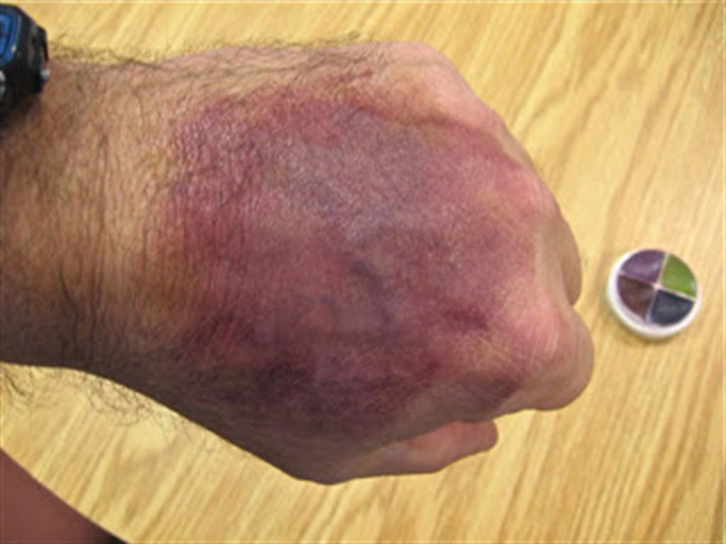
PHOTOGRAPHS

Slide 49
Factors modifying size and shape of bruise
1. Condition and type of tissue
In vascular and loose parts such as face, vulva, scrotum, large bruise are produced by small impact.
In boxers and athletes, bruising is much less because of good muscle tone.

Slide 50
2. Age
-Children bruise more easily because of softer
tissues and delicate skin.
- Old person easily because of loss of flesh and
cardiovascular changes.
3. Sex
Women bruise more easily than man because of
more subcutaneous fat and more delicate tissues.

Slide 51
4. Colour of skin
More clearly seen in fair-skinned persons than those with dark skin.
5. Natural diseases
Prominent bruising occurs easily even with small trauma in persons with diseases like haemophilia, scurvy, Vit.K deficiency, arteriosclerosis etc.

Slide 52
6. Gravity shifting of the blood
A deep bruise, especially that due to the crushing of the tissue against the bone may take a long time to become visible and may not appear below the actual point of impact. It is Known as ‘Ectopic bruising Percolated’ or ‘Migratory bruising’

Slide 53
Examples of Migratory bruising
1. Black eye may be caused by -
I. Direct trauma
II. Blunt impact to forehead
III. Fracture of floor of anterior cranial fossa
2. A bruise behind ear indicates the basal fracture
(Battle’s sing)
3. Bruise in neck due to fracture in jaw
4. Bruise in thigh due to fracture in pelvis
5. Bruise on ankle due to blow on calf of leg

Slide 54
Patterned bruising:
Is one which indicates the shape and size of
the part of the object causing it
Examples :-
A blow from solid body, like hammer or fist usually produce round bruise
Blows with rod, stick or a whip produces 2 parallel, linear haemorrhages (Railway line or tramline type)
Woven, spiral or plaited ligature
Elliptical marks of suction or biting

Slide 55
Delayed bruising
A superficial bruising may appear immediately as dark-red swelling.
A deep bruise may take several hours and deeper extravasation of blood may not appear.
So, one more examination should be carried out 48 hrs after the first examination.

Slide 56
Deep tissue and organ contusions
They are seen only during autopsy
Contusion of brain may initiate the enough swelling which gradually increases due to acid accumulation leading to confusion, coma and death
Contusion in vital centres which control the respiration and BP may be fatal even with small trauma
Contusion of heart may cause arrhythmia or stoppage of cardiac action and death
Contusion of other organ may cause the rupture of that organ and bleeding into the body cavity and death

Slide 57
Age of the bruise:
At first – Red
Few hours to 3 days – Blue
4th day – Bluish black (Haemosiderin)
5-6 Days – Greenish (Haematoidin)
7-12 days – Yellow (Bilirubin)
2 weeks – Normal

Slide 62
Differences between P.M. Staining and Bruise
Traits | Post-mortem staining | Bruise
1. Causes | Due to dilatation of blood vessels in dermis | Due to rupture of blood vessels
2.Site | Seen on Dependent parts of body | Any where on the body
3. Appearance | No elevation of the involved area | Swollen due to extravasated blood and oedema
4. Epidermis | Not abraded | May be abraded
5. Margins | Clearly defined | Merge with the surrounding area
6. Colour | Uniform bluish purple in colour | Colour changes with the age of the injury
7.On Incision | Blood is seen in blood vessels, which can be easily washed away | Extravasated and clotted Blood is seen in surrounding tissues ,it cannot be washed away easily
8. Effect of pressure | Absent | Little lighter over the area of pressure

Slide 63
Differences between True Bruise and Artificial Bruise
Traits | Artificial bruise | True bruise
1.Cause | Juice of Calatropis, Marking nut, Plumbago rosea | Trauma
2.Site | Exposed accessible parts | Anywhere
3.Colour | Dark brown | Typical colour changes
4.shape. | Irregular | Usually round
5.Margins | Well defined and regular | Diffuse and irregular, No vesicle
6.Redness and inflammation | Seen in the surrounding skin | Seen in the site
7.Contents | Acrid serum | Extravasated blood
8.Itching | Present | Absent
9.Vesicles | May be seen on the fingertips | Absent
10.Chemical tests | Positive | Negative

Slide 64
Medico legal importance
1. Patterned bruises may indicate the weapon causing them
2. Colour changes can indicate the age of the bruises
3. Distribution of bruises can indicate the character and manner of injury
e.g. - In throttling, the bruises and nail marks are present on the neck
- In rape victim, bruises are present on inner aspect of thigh and genitalia

Slide 65
Bruises are of less value than abrasion because of
the following reasons :
Size of the bruise may not correspond to that of weapon
2. They may become visible several hours after the
injury
3. They may appear away from the site of impact
4. They do not indicate the direction of impact

Slide 66
Complications
1. A contusion may contain 20-30 ml blood. Multiple contusion can cause death due to shock and internal haemorrhage.
2. Gangrene and death of tissue
3. Pooled blood serves as the reservoir of infection like clostridium bacteria.
4. Pulmonary fat embolism in rare cases

Slide 67
Circumstances of injuries
1. Accidental bruises are most common
2. Self inflicted bruise are rare and are seen over the
accessible parts of body.
3. Homicidal bruises may be seen on any part of the
body
4. Multiple contusions from small trauma are seen in
alcoholics
5. Presence of mud, sand, grease or oil indicate the
manner of death.
6. It is not possible to differentiate an injury caused by
fist or weapon or fall

Slide 68
Questions

Slide 69
1. Pressure abrasion is caused by:
Violent impact
Rupture of superficial layer of skin
Caused by scrapping of skin
Crushing of superficial layer of skin

Slide 70
2. Greenish colouration in contusion is due to:
Hemosiderin
Hematoidin
Bilirubin
Biliverdin

Slide 71
3. Friction burn is due to:
Friction injury
Electrical injury
Fire arm injury
Thermal injury

Slide 72
4. Abrasion completely heals in _____ days.
1day
3days
7days
10days

Slide 73
5. A contusion can be differentiated from post-mortem staining by:
Diaphanous test
Gettler’s test
Icard test
Incision test

Slide 74
6. Black eye is :
An injury to eye ball
An injury to cornea
Contusion
Black pigmentation of eyelids

Slide 75
7. Brush burn is due to
Burn by dry heat
Burn by wet heat
Burn by electric heat
Abrasion

Slide 76
8. Contusion is caused by :
Sharp edged weapon
Blunt force
Pointed weapon
Knife

Slide 77
9. Graze is a type of
Bruise
Abrasion
Incised wound
Punctured wound

Slide 78
10. Contusion produced immediately after death, does not show:
Extravasation of blood
Damage of epithelium
Coagulation of tissues
All of the above

Slide 79
Thank you

